Slide 1
Native Workforce Development Data
December 7, 2023
WGNNC
Casey Lozar
Vice President, Director-Center for Indian Country Development

Slide 2
The views expressed here are the presenters’ and not necessarily those of the Federal Reserve Bank of Minneapolis or the Federal Reserve System.

Slide 3
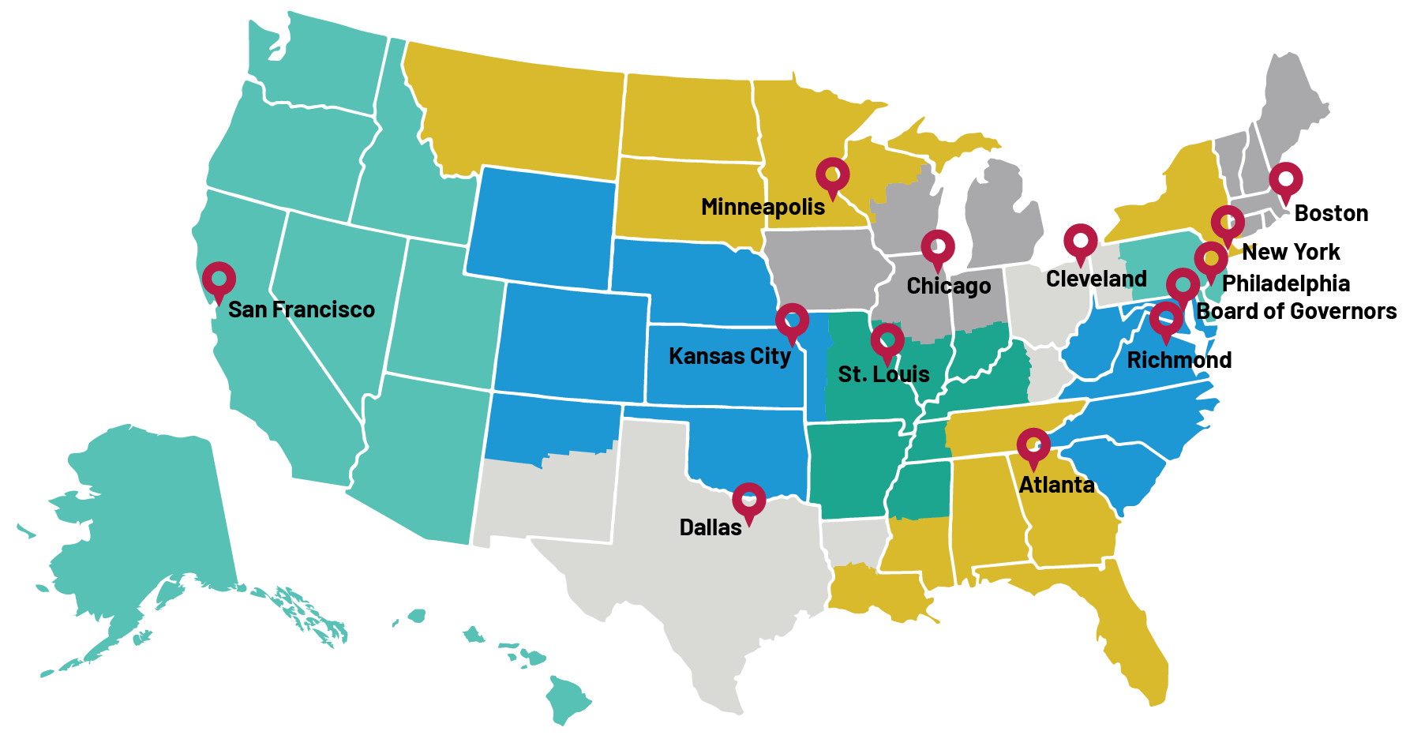
The Federal Reserve (“The Fed”) and Indian Country
Federal Reserve Bank of Minneapolis mission statement:
We serve the public by pursuing a growing economy and stable financial system that work for all of us.
Notes:
The Fed is the central bank of the United States
12 Federal Reserve Banks in total, shown here on map
The Minneapolis Fed serves the Ninth Federal Reserve District, which includes Montana, North Dakota, South Dakota, Minnesota, 26 counties in northwestern Wisconsin, and the Upper Peninsula of Michigan
Minneapolis Fed is home to CICD. CICD serves Indian Country nationwide
The Fed system works toward a healthy economy. It has two main job: pursuit of price stability (using money supply and credit tools to keep inflation in check) and pursuit of maximum sustainable employment (everyone who wants a job can get a job)
A healthy economy includes equitable access to economic opportunity—including in Indian Country

Slide 4
CICD mission and vision
Our mission is to advance the economic self-determination and prosperity of Native nations and Indigenous communities through actionable data and research that make substantial contributions to public policy.
We envision a future in which resilient and robust Indian Country economies enhance the economic, community, and cultural well-being of Native nations, Indigenous communities, and the United States.

Slide 5
Native Labor Market Outcomes-Pre-Pandemic to Today
Labor Force Participation is lowest in the country for Natives in rural areas
Less than half of Native individuals employed
Unemployment rates are historically 2X more for all Natives and 3X for Natives on reservations
December 2019-November 2023

Slide 6
The Native workforce is disproportionately concentrated in service sector occupations
18% of the nation’s labor in services compared to approx. 31% for Natives
Service sector incomes are generally low
Educational attainment rates may be a critical barrier to labor force participation as well as industry concentration

Slide 7
The effects of a concentrated Native labor market at the onset of the pandemic
Native unemployment rates spike to 26% in April 2020 (2.5X the national average)
Considerably higher for those on reservations
Ability to withstand economic and labor market shocks continue to be a challenge

Slide 8
Native workers ability to do remote work lags other groups
8% fewer Natives could telework in the early pandemic (in total)
The telework outcomes were much greater for Native workers on tribal lands
Likely a product of worker concentration in services AND lack of broadband coverage and equipment

Slide 9
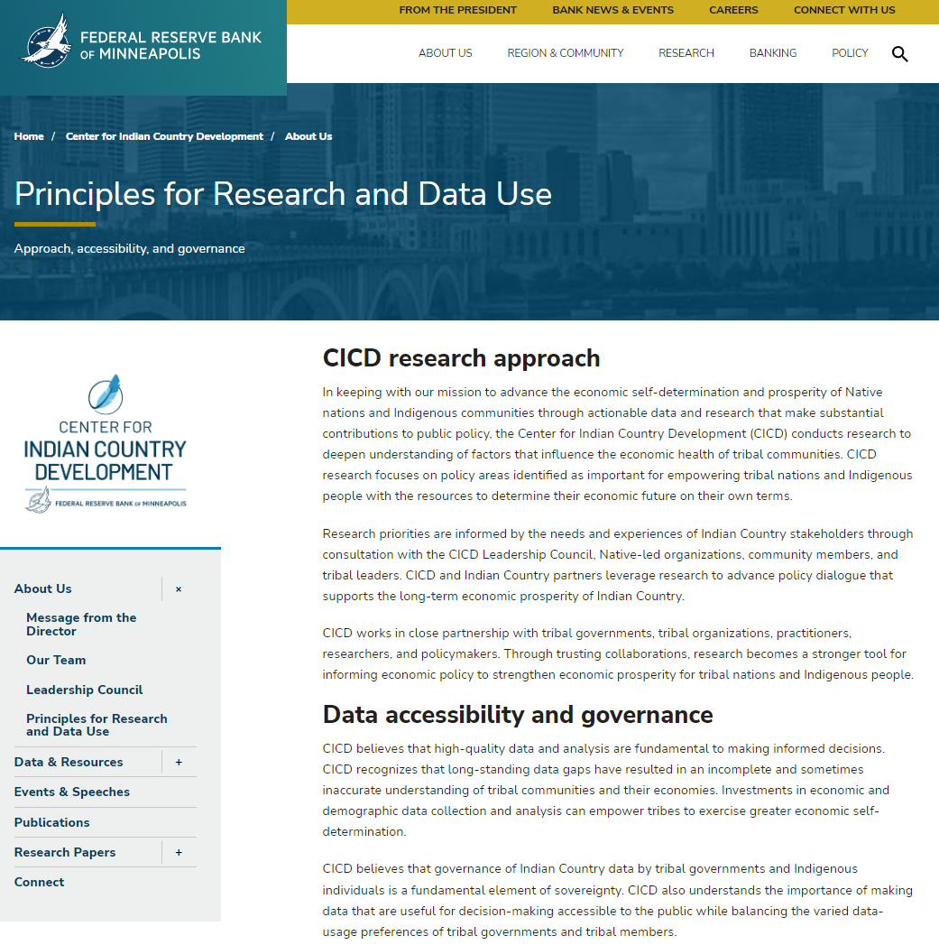
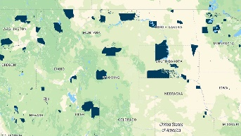
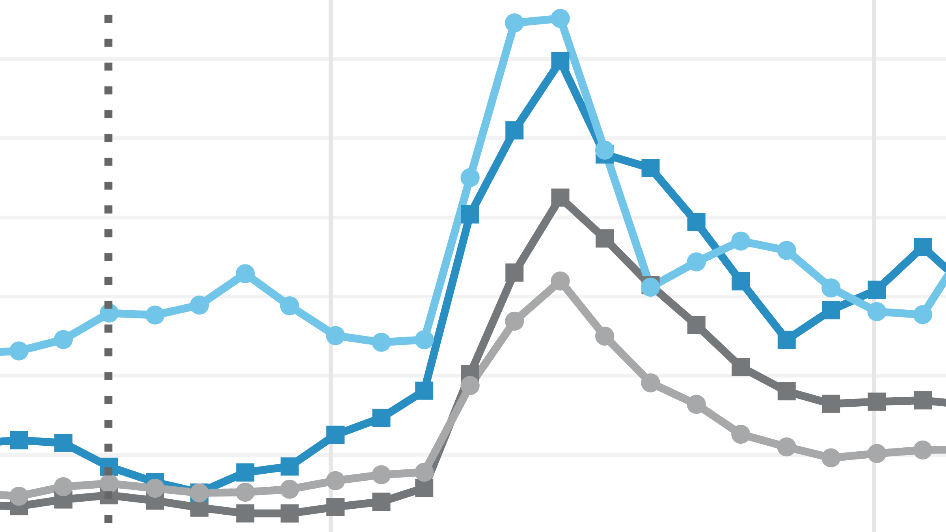
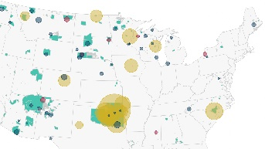
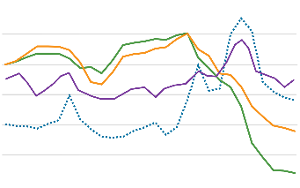
Data initiative
Addressing chronic data gaps to empower Native individuals and communities to shape their economic futures and tell their stories
Native American Funding and Finance Atlas
Native American Financial Institutions Map
Native American Labor Market Dashboard
Reservation Profiles
Forthcoming: Native Entity Enterprise Dataset
www.minneapolisfed.org/indiancountry/about-us/principles-for-research-and-data-use

Slide 10
Data gaps and quality issues for Indian Country
Small sample sizes often lead to Natives being denoted with an asterisk and left invisible in many data sets (Asterisk Nation)
Low samples size create considerable noise in longitudinal data (use of rolling averages typical)
Data quality constrained by self-certification of Native affiliation versus tribal citizenship
Siloing of Indian Country and tribal data within government agencies (tribal, state and federal)
Historical weaponization of Indian Country data impacts trust among Native nations
The best data in Indian Country is found among Native nations (administrative data capacity varied)
Data sovereignty is a critical principle in addressing data gaps in partnership with Indian Country

Slide 11
Tribal administrative data- Survey of Native Nations Pilot
Based in a Qualtrics platform
Created by CICD and conducted in collaboration with tribal governments in Montana (others to follow)
Gathers 2019 tribal government revenues and expenditures (payroll, revenues sources, and categories of expenditures)
Utilizes secure data collection and handling to protect tribal data
Follows the Principles for Research and Data Use
Honors tribal data sovereignty and governance
Advances economic self-determination and the prosperity of Native nations and Indigenous communities through actionable data and research

