Slide 1
Workforce Matters 2024 Q4 Policy Update
December 13, 2024

Slide 2
Briefing Overview
Updates
Infrastructure Learning Community
2024 Grants Issued to date
Sector Strategies Framework
Infrastructure TEN update
Apprenticeship Investment Strategies & Initiatives
National Apprenticeship Week
Discussion

Slide 3
Building the Vision | Four Guiding Priorities for the Workforce Vision
Open Opportunities for Vulnerable Workers and Communities Ensure our programs focus on workers and communities who have been left behind—from reentry, to rural, to opportunity youth
New Industry Partnerships that Lead to Real, Good Jobs Broker and build partnerships with business/workers to ensure all training leads to good jobs across sectors (e.g., infrastructure, supply chain, ITC manufacturing and education)
Building a Better Care Economy Support good jobs and protections for care workers—from nursing, early care, mental health, and more—with a focus on low-wage, BIPOC, and women workers
Action Today for the Future of Work Engage local leaders and the private sector now to prepare, support, and invest in workers and communities to prepare for jobs of the future and emerging industries

Slide 4
Reinvigorating Federal – State – Local Partnerships
Informational – Not For Distribution

Slide 5
Infrastructure Learning Community (ILC)
What:
The ILC, a technical assistance initiative from the Department of Labor in partnership with Jobs for the Future, offers stakeholders an opportunity to collaborate, share resources, and learn from peers leading initiatives funded by major federal Investing in America programs, including the Bipartisan Infrastructure Law, CHIPS and Science Act, and the Inflation Reduction Act. ILC participants will gain access to a centralized hub filled with subject matter expert insights, relevant resources, and opportunities for real-time collaboration.
How can you support these efforts:
Share resources and case studies related to effective infrastructure workforce solutions.
Support connectivity to philanthropy-driven infrastructure efforts, and support connections at the local and regional level related to infrastructure activities.
Share with your networks to support growth and collaboration across the ILC.
Learn more and register to join the ILC here: WorkforceGPS – Infrastructure Learning Community (ILC). If you have additional questions, email ILC@dol.gov.

Slide 6
Highlights of Grants Awarded in Q4
Grant Program | Award Amounts | Date
Pathways Home 5 | $56 Million | July 2, 2024
Growth Opportunities – Two Rounds | $47 Million | July 2, 2024
Workforce Pathways For Youth | $20 Million | September 2024
WIOA NFJP Training Grants | $90.9 Million | September 2024
WIOA NFJP Housing Grants | $6.5 Million | September 2024
SCSEP – Program | $313 Million | September 2024
SCSEP - Evaluation | $18.4 Million | September 2024

Slide 7
Highlights of Grants Awarded in Q4
Grant Program | Award Amounts | Date
Workforce Opportunity for Rural Communities (WORC) Initiative – Round 6 | $49 Million | September 2024
Critical Sectors Job Training Grants | $13 million | September 2024
Building Pathways to Infrastructure Grants – 2 | $35 million | September 2024
YouthBuild | $99 million | December 2024
Next Level Now TA Collaborative FOA | $1.5 million | Currently Open until 2/6/24

Slide 8
Forecasts of Upcoming Grant Awards and Funding Opportunity Announcements
Grant Program | Funding Amount | Timeframe
Strengthening Community Colleges - Round 5 | $65 million | Late 2024
REO Pathways Home 6 | $56 million | Early 2025
REO Growth Opportunities | $47 million | Early 2025
Cybersecurity Upskilling Initiative | $10 million | Spring 2025
Workforce Opportunities for Rural Communities (WORC) Round 7 | TBD
YouthBuild Program Year 2025 | TBD
Workforce Pathways for Youth Round 5 | $20 million | Spring 2025

Slide 9
Sector Strategies – Updating the Framework
Reviewed research and responses to ETA’s Sector Strategies Request for Information
Held listening sessions with subject matter experts and state and local practitioners
Revised Framework to reflect feedback and promising practices
Informational – Not For Distribution
12/13/2024

Slide 10
Insights from Research and Listening Sessions
More clarity around distinctions and
relationships among sector partnerships, strategies, and training programs.
Clarify definitions for intermediary, backbone organization, and other roles.
Leadership and vision are critical
pieces that appear to need more focus.
Weave worker voice and equity
throughout all Framework elements.
Enhanced connection between
sector strategies and career pathways.
Further address funding, staffing,
and organizational support needs.
Ongoing data review is important, including industry and worker engagement and goal refinement.
Additional focus on desired industry engagement levels, including employer collaboration in program design.
Informational – Not For Distribution
12/13/2024

Slide 11
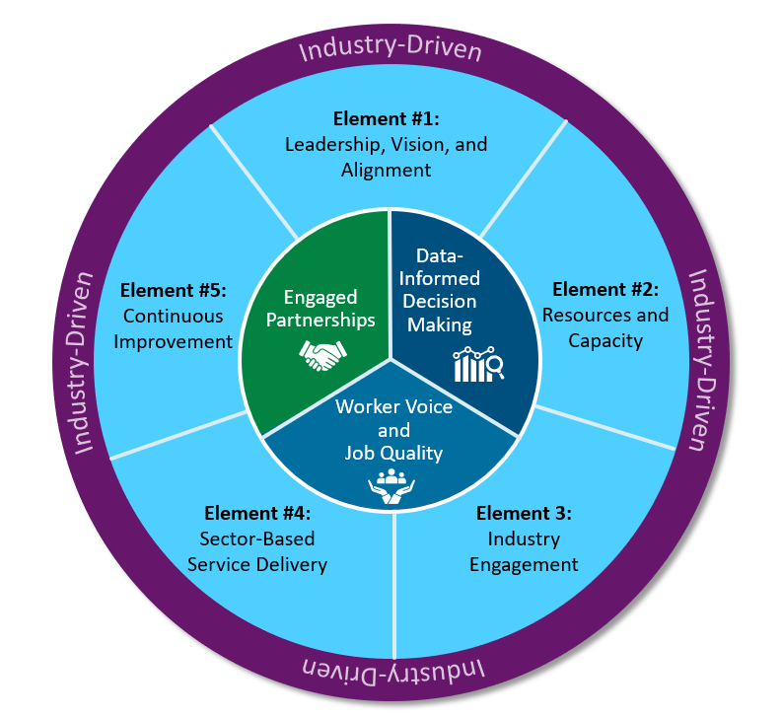
Updated Framework Structure
Industry-Driven Foundation
Three Core Components
Five Key Elements
Informational – Not For Distribution
12/13/2024

Slide 12
DOL ETA Sector Strategies Framework Resources
DOL-ETA Sector Strategies Framework Page
Includes all Framework resources listed below as well as accompanying resources to the implementation guide and collections of sector strategies resources and promising practices.
WorkforceGPS - 2024 Sector Strategies Framework
DOL-ETA Sector Strategies Framework
This resource describes the core components and key elements of a successful regional sector strategy.
2024 Sector Strategies Framework
DOL-ETA Sector Strategies Framework Self-Assessment and Action Planning Tool
This resource accompanies the Framework and Implementation Guide to help regional sector partnerships assess their readiness and efficacy in launching, implementing, and sustaining a sector strategy approach.
Self-Assessment and Action Planning Tool
DOL-ETA Sector Strategies Implementation Guide
This resource takes a process-oriented approach to launching, implementing, and sustaining sector partnership efforts and presents valuable templates and resources to support implementation efforts.
Sector Strategies Implementation Guide
12
Informational – Not For Distribution
12/13/2024
Notes:
1 min

Slide 13
Building Pathways to Infrastructure Jobs Grant Program
Round 1: DOL awarded ~$94M in grants to support 34 public-private partnerships to develop, implement, and scale worker-centered sector strategy programs aligned to H-1B industries and occupations that connect to IIA workforce needs.
Development Track: Grantees will develop and implement local/regional worker-centered sector strategies
Scaling Track: Grantees will scale existing and proven effective worker-centered sector strategy programs
Round 2: DOL awarded nearly $38 million in grants to enable an additional 13 public-private partnerships across nine states to prepare workers for good-paying infrastructure jobs.
These two rounds of funding represent a combined total investment of $130 million to support the growing demand for a skilled infrastructure workforce.

Slide 14
Infrastructure TEN Update
ETA is working to publish an update to Training and Employment Notice (TEN) No. 08-22, Building Pathways to Infrastructure Careers: Framework for Preparing an Infrastructure Workforce.
TEN No. 08-22 aimed to promote a framework for all workforce stakeholders, including infrastructure project leads, to engage the public workforce system in implementing the Bipartisan Infrastructure Law with strong workforce commitments and proven strategies that produce high-quality education, training, and employment opportunities for all workers.
The update incorporates funding opportunities available through the Creating Helpful Incentives to Produce Semiconductors (CHIPS) and Science Act and the Inflation Reduction Act, as well as infrastructure workforce resources from federal agency partners.
It also incorporates implementation examples of recommendations, to illustrate how they can be operationalized.
We expect the update to publish soon.

Slide 15
Funding Driving Innovation: Over $730 million
State Expansion
$99 million in State Apprenticeship Expansion, Equity and Innovation grants
$115.2 million in State Apprenticeship Expansion Formula grants
Competitive Grants
$366.7 million in Apprenticeship Building America grants
Focus on pre-apprenticeships, pathways to RA, education Hubs
$17.7 million in WANTO grants
Industry Engagement & System Modernization
Industry Intermediaries (over $47 million)
Registered Apprenticeship TA Centers of Excellent ($31 million)
Enhancements to Apprenticeship.gov and E-Tools d text
Labor Partnerships ($20 million)
Evaluation and research
RA Academy
Opportunities: Explore, Connect or Partner with 1) existing RA grants/grantees or 2) intermediaries
Contact for Investments: Megan Baird, Deputy Administrator, U.S. DOL/ETA Office of Apprenticeship

Slide 16
Key Apprenticeship Initiatives
Strategic Initiatives
Targeted Outreach: Industry Sprints/Challenges
Apprenticeship Ambassadors
Apprenticeship Trailblazers
ACA Recommendations
Policy and Guidance Updates
Access & Opportunity
Increased Policy Direction
Enhanced Compliance Efforts
Strategic Partnerships with Equity Organizations
Improved Data Analysis and Transparency
Over 1 million individuals have started an apprenticeship since the start of the Biden Administration: Youth (350K); Non-traditional occupations (50%); Underserved communities (426K)

Slide 17
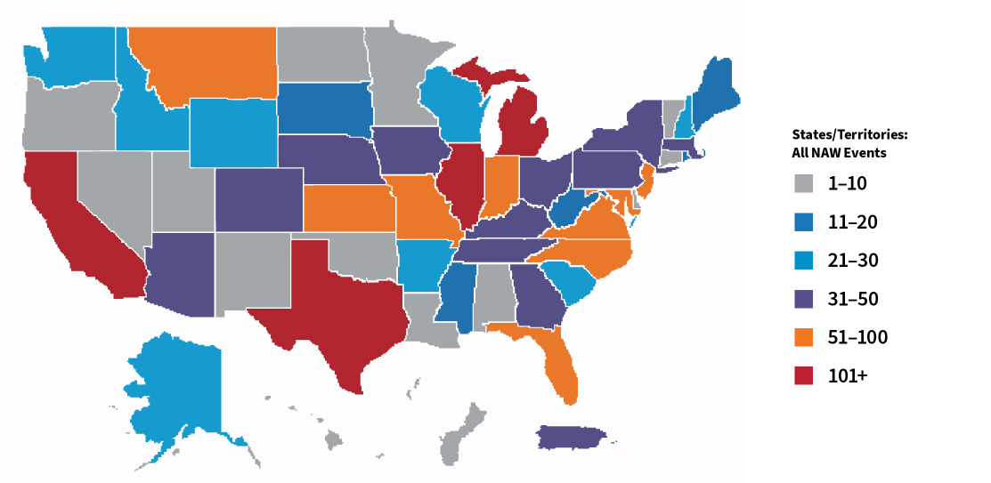
2024 By the Numbers
2,503 Activities
909 Proclamations
1,594 Events
The 10th Annual National Apprenticeship Week (NAW) took place from November 18-24, 2024!
The theme for the 2024 celebration was "National Apprenticeship Week: 10 years of Engagement Expansion, and Innovation."
NAW is a nationwide celebration that brings together business leaders, career seekers, labor, educational institutions, and other critical partners to demonstrate their support for apprenticeship.
Get ready for National Apprenticeship DAY on
April 30, 2025!
17
Informational – Not For Distribution
12/13/2024

Slide 18
Discussion

