Slide 1
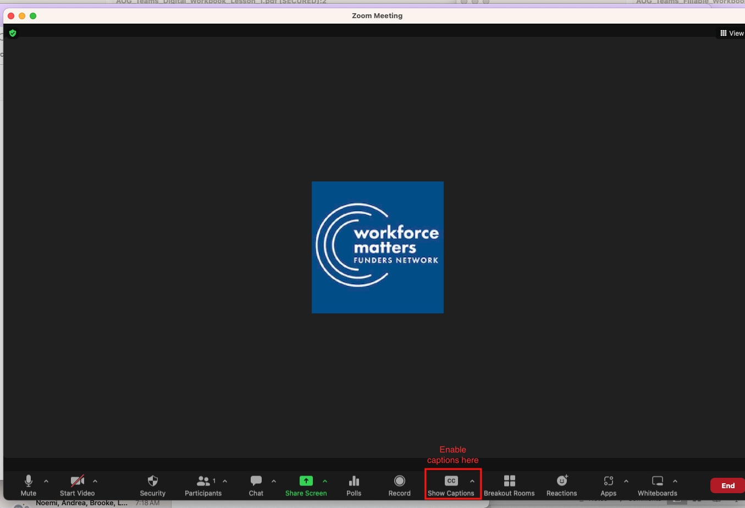
Welcome to today’s webinar! We’ll get started in just a few minutes.
You can participate in the audio portion of this webinar by dialing in via phone or by using your computer’s built-in speakers and microphone.
Note: This webinar is being recorded.
Please silence your phones when you’re not speaking or asking a question.
Unless otherwise noted, we will distribute any recordings and materials after the call
The views and opinions expressed on this webinar are those of the presenters and do not necessarily reflect those of Workforce Matters or our members.
Notes:
Before we begin today’s webinar, we do want to let you know that this presentation is being recorded and will be made available to Workforce Matters members through the video library accessible on our website
Please remember to silence your phones when you’re not speaking so that we can minimize background noise.
You are welcome to ask questions throughout the call, either by using the chat feature or by raising your hand and unmuting your line to ask your question live when we get to the Q&A section of the call.
Participants are welcome to enable Zoom’s live transcription feature to access captions of this webinar by clicking the CC icon to show captions. An illustration of how to do this is on your screen.
We encourage each of you to give our speakers an idea of who’s on the line today by introducing yourselves in the chat window.
Name
Organization
What prompted you to join today’s call?
We’ll start the recording now and go ahead and get started.
***HIT RECORD***

Slide 2
Apprenticeship:
What Funders Need to Know Right Now
March 5, 2026
Notes:
Good afternoon, and welcome to today’s webinar -- Apprenticeship: What Funders Need to Know Right Now. My name is Loh-Sze Leung, and I am one of the co-directors of Workforce Matters.
Workforce Matters is pleased to be able to offer quarter webinars to our members and field partners on timely topics in the workforce field. In our last member survey, we heard loud and clear that folks wanted to learn more about current opportunities in apprenticeship, so we thought we would make that the first webinar of the year!
Before we get too much further, a little background on Workforce Matters and our speakers

Slide 3
About Us
Workforce Matters is a national network of grantmakers that draws on expert and practitioner knowledge and works together to strengthen workforce development philanthropy such that it empowers workers, learners, and job seekers to realize their full potential; dismantles inequities based on race, gender, ability, and other individual characteristics; and advances equitable education and employment outcomes for youth and adults.
Notes:
Before we begin, some quick background information:
Workforce Matters is a peer network of funders that draws on expert and practitioner knowledge to strengthen workforce development philanthropy and advance equitable access to quality education and employment for young people and adults.
Membership in Workforce Matters is free and available to any workforce development grantmaker based at a foundation or other philanthropy. I know we are welcoming a number of field partners on the call today as well. Thank you for joining us. Just a quick note that Workforce Matters maintains a non-solicitation policy for all of our events and webinars in order to provide a distraction-free environment for members and guest attendees.

Slide 4
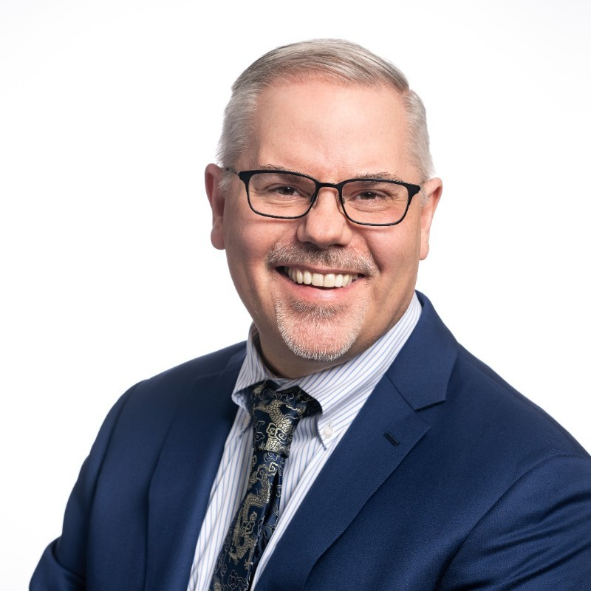
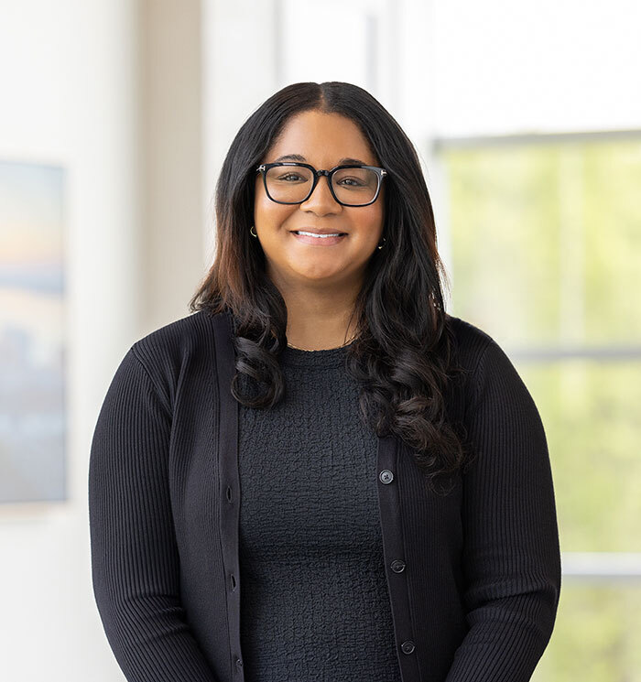
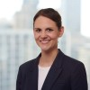

Introductions
John Colborn
Apprentice-ships for America
Brittany Corde
Ascendium Education Group
Laura Love
Strada Education Foundation
Laura Mutis
JPMorgan Chase
Notes:
With that, let’s kick off our conversation. We are fortunate to be joined by …..
John Colborn, Executive Director of Apprenticeships for America (AFA) - a national intermediary focused on apprenticeship and three of Workforce Matters’ Steering Committee Members
Laura Love, Sr. VP of Work-Based Learning at Strada Education Foundation
Laura Mutis, Vice President, Jobs & Skills, Global Philanthropy, JPMorgan Chase
Brittany Corde, Senior Program Officer, Ascendium Education Group

Slide 5
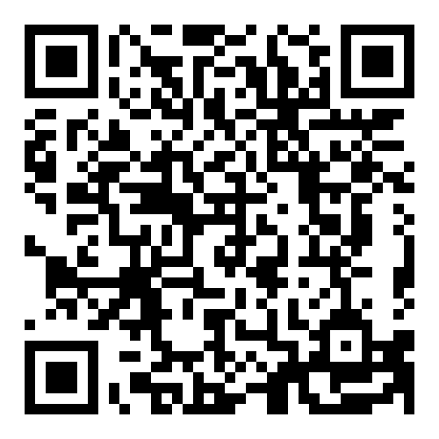
Join our Affinity Group!
We will be hosting 3 Apprenticeship Affinity Group meetings over the course of the year.
Meetings are for funders investing in apprenticeship strategies
Tell us more about your interests and sign up here:

Slide 6
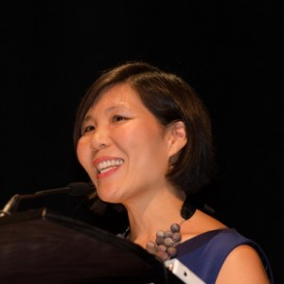
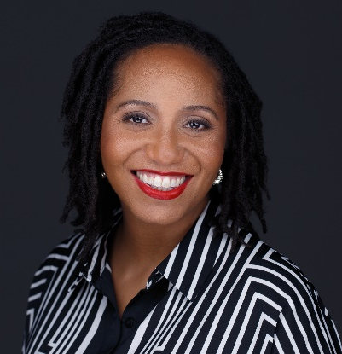
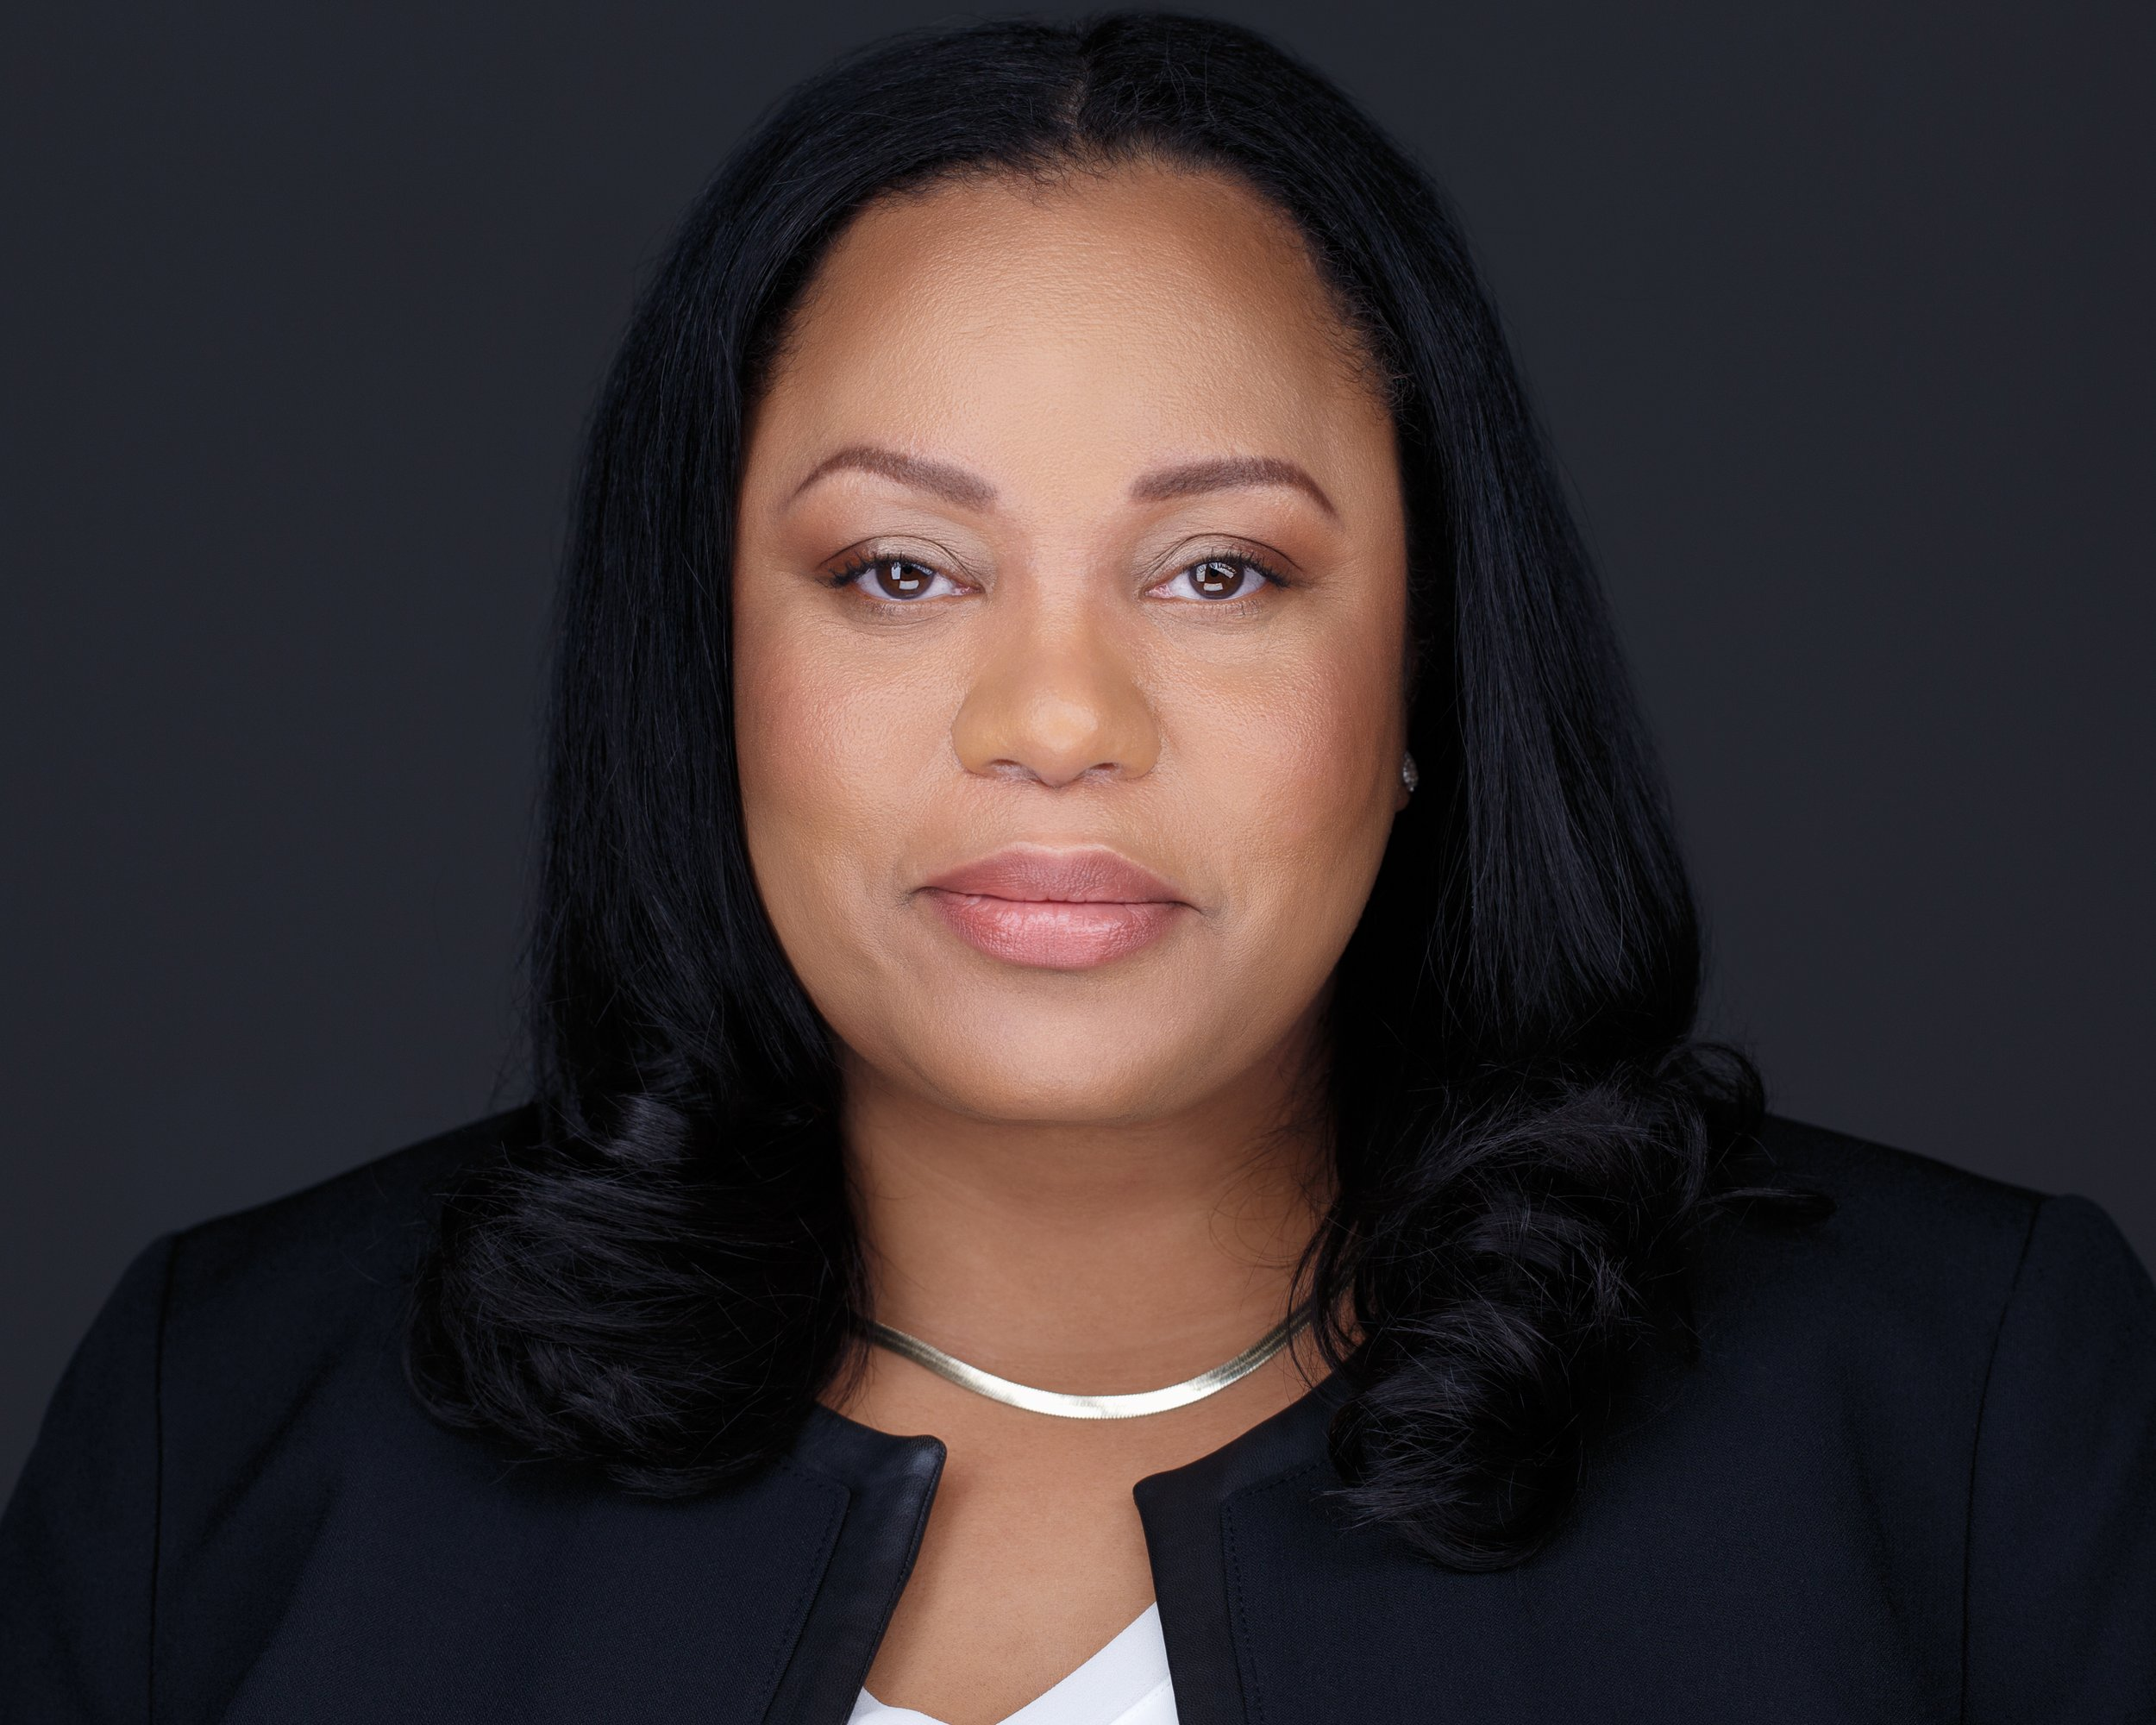
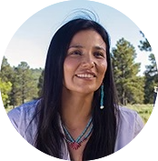
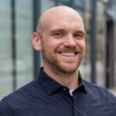
Our Team
Loh-Sze Leung
Co-Director
Clair Minson
Co-Director
Natasha Hale
Project Manager, WGNNC
Kale Roberts
Membership Coordinator
info@workforce-matters.org

Slide 7
Upcoming Events
March 25 – Post-secondary + Workforce Funders Affinity Group
March 26-27 – EOF Budget and Tax Policy Briefing
March 31 – Budget and Tax Policy Debrief for WFM Members
April 22 – In-person networking dinner in Dallas
May 13 – Spring Workforce Policy Briefing
Keep up with our events at https://workforce-matters.org/events/
Notes:
Update as necessary

Slide 8
2026 Steering Committee
Porsha Cropper The Eli and Edythe Broad Foundation Los Angeles, CA Co-Chair, 2025-26 Nomzana Augustin WES Mariam Assefa Fund New York, NY Nina Bershadker Taft Foundation New York, NY Robin Boggs Accenture Atlanta, GA Elizabeth Cheung Conrad N. Hilton Foundation Westlake Village, CA Stephanie Comai Ralph C. Wilson, Jr. Foundation Detroit, MI
Brittany Corde Ascendium Education Group Madison, WI Galiana Fajardo REDF San Francisco, CA Anna Fontus ECMC Foundation Los Angeles, CA Tuquan Harrison James Irvine Foundation San Francisco, CA Ranita Jain Annie E. Casey Foundation Baltimore, MD Donna James-Harvey Holloway Family Foundation Colleyville, TX Jeremy Kelley Gates Foundation Seattle, WA
Lauren N. King, Ph.D. W. K. Kellogg Foundation Battle Creek, MI Laura Love Strada Education Foundation Indianapolis, IN Laura Mutis J.P. Morgan Chase & Co New York, NY Kwelin Pipkin American Institutes for Research Washington, DC Georgia Reagan Lumina Foundation Indianapolis, IN Danielle Vetter MetLife New York, NY
Notes:
Update as necessary

Slide 9
Thank you to our
2025-2026 Supporting Members
AARP Foundation ∙ Accenture ∙ Allstate Foundation ∙ American Institutes for Research
Eli & Edythe Broad Foundation ∙ Annie E. Casey Foundation ∙ Ascendium Education Group ∙ Gates Foundation ∙ Deaconess Foundation ∙ ECMC Foundation ∙ Fairfield County's Community Foundation Conrad N. Hilton Foundation ∙ The Holloway Family Foundation ∙ Indeed ∙ JPMorgan Chase ∙ The James Irvine Foundation ∙
W.K. Kellogg Foundation ∙ Kessler Foundation ∙ LANL Foundation ∙ Lumina Foundation McGregor Fund ∙ MetLife ∙ Mitsubishi Electric America Foundation ∙ REDF ∙ Siemens Foundation ∙ The Smidt Foundation ∙ Strada Education Foundation ∙ Taft Foundation ∙ Truist Foundation ∙ Walmart.org ∙ The Harry and Jeanette Weinberg Foundation ∙ Workday Foundation ∙ WES Mariam Assefa Fund ∙ Ralph C. Wilson, Jr. Foundation
Notes:
Update as necessary

Slide 10



Stay Connected
/workforce-matters-funders-network
www.workforce-matters.org
info@workforce-matters.org

